Slide 1

Development of machine learning models to process Electronic Health Records – Imputation Strategies
Week 22 Meeting, 21/3/2021

Slide 2
How important is hypothesis testing?

Slide 3
How much theory should I include from paper?
For example How in depth should I go into the paper
http://eprints.lse.ac.uk/108170/1/Lall_Robinson_PA_Forthcoming.pdf

Slide 4
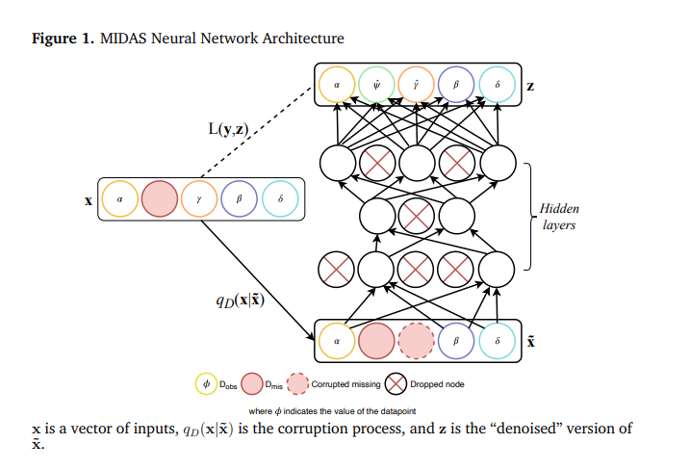
Can I use other people’s figure from their paper?

Slide 5
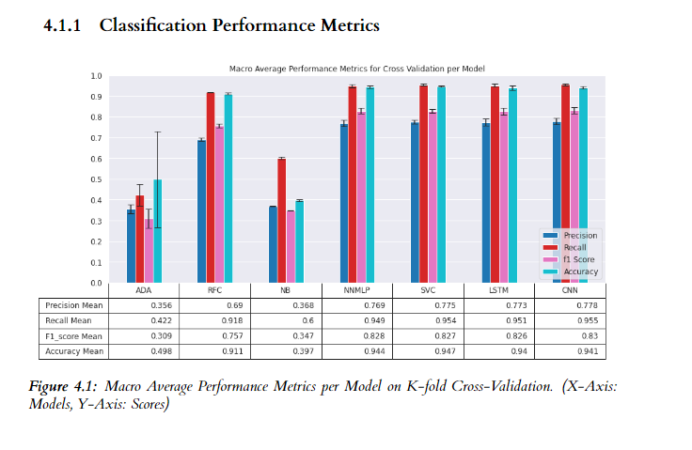
Classification Results

Slide 6
Diagrams
For preprocessing and extracting pipeline

Slide 7
Distribution analysis

Slide 8
Add figures for MIMIC database info

